Slide 1
Funding Your
Graduate Education
Dr. Adrienne P. Stephenson, Director
Dr. Thomas J. Whitley, Assistant Director
Office of Graduate Fellowships and Awards (OGFA)
THE FLORIDA STATE UNIVERSITY | THE GRADUATE SCHOOL

Slide 2
Getting Started
Things to consider…
Managing TIME/OBLIGATIONS
Funding Opportunity Fit
General Application Timeline
The Application Experience
Preparation - Application Components
Writing and Revising Essays
Additional support involved
THE FLORIDA STATE UNIVERSITY | THE GRADUATE SCHOOL

Slide 3
Finding the Right Fellowship for You
Demographics (gender, nationality, ethnicity, etc.)
Research (may be discipline specific)
Potential (future goals)
Travel to conduct research, teach English, learn a language
THE FLORIDA STATE UNIVERSITY | THE GRADUATE SCHOOL

Slide 4
Application Timeline
Time Prior to Deadline | Task to Complete
It’s Never Too Early to Get Started | Meet with OGFA to discuss funding opportunities
3-4 Months | Create a funding search template & submit to OGFA
2-3 Months | Submit an initial draft of documents to OGFA for structure & content review Submit draft to major professor for review Submit draft to the Writing Center for review
2 Months | Submit revised drafts to OGFA/Writing Center
1 Month | Obtain all required signatures Request letters of recommendation
1 Month | Submit revised drafts to OGFA/Writing Center
1-2 Weeks | Submit application
THE FLORIDA STATE UNIVERSITY | THE GRADUATE SCHOOL

Slide 5
The Application Experience
Applications have a lot of moving parts
Criteria
Is this funding opportunity a good fit for you?
What are the reviewers looking for?
Overall and for every part of the application
Timeline
Application deadline – Planning ahead – When should you apply?
Requesting additional materials (e.g., letters of recommendation)
Several drafts, feedback, revision
Feedback from multiple sources
OGFA
Major advisor/someone familiar with your field of study and/or research
THE FLORIDA STATE UNIVERSITY | THE GRADUATE SCHOOL
Notes:
CV
Tailor for this specific fellowship
Personal Statement
Every one is different, tailor them
This is where you show that you are a good fit (and a good investment)
Research Proposal
Give them what they’re asking for
Budget
Work with your advisor/PI; must be realistic and reasonable
Timeline
Take this very seriously, as it shows feasibility
Can be an asset for you even if you do not win the fellowship
Research progress made to date and your planned sequence of tasks to be completed, with estimated timetable.
LOR
One should be from your advisor/PI
Should speak to your project, its impact on the field, and your ability to complete the project according to your proposed timeline
Give your recommenders your application materials (proposal, timeline, etc.)

Slide 6
The Application Experience
Applications have a lot of moving parts
Developing a strong and compelling application
CV
Personal Statement
Research Proposal
Letters of Recommendation
Budget, Timeline Justification
IRB Approval (if applicable)
Review, Revise, REPEAT, REPEAT, REPEAT, Submit
THE FLORIDA STATE UNIVERSITY | THE GRADUATE SCHOOL
Notes:
CV
Tailor for this specific fellowship
Personal Statement
Every one is different, tailor them
This is where you show that you are a good fit (and a good investment)
Research Proposal
Give them what they’re asking for
Budget
Work with your advisor/PI; must be realistic and reasonable
Timeline
Take this very seriously, as it shows feasibility
Can be an asset for you even if you do not win the fellowship
Research progress made to date and your planned sequence of tasks to be completed, with estimated timetable.
LOR
One should be from your advisor/PI
Should speak to your project, its impact on the field, and your ability to complete the project according to your proposed timeline
Give your recommenders your application materials (proposal, timeline, etc.)

Slide 7
Pivot: Funding Database
The Office of Research at FSU pays for Pivot
3rd party database of external funding opportunities
Funding Opportunities=27,000+ records
Scholarly profiles= 3.2 million profiles
Pivot suggests funding based on Pivot profile…and vice-versa
Free access
One stop searching
Allows you to set up searches and alerts
THE FLORIDA STATE UNIVERSITY | THE GRADUATE SCHOOL
Notes:
Why use a funding database?

Slide 8
Other Funding Databases
Fellowship Finder from the University of Illinois
Cornell University Fellowship Database
UCLA GRAPES Funding Database
GradFund from Rutgers
THE FLORIDA STATE UNIVERSITY | THE GRADUATE SCHOOL
Notes:
Why use a funding database?

Slide 9
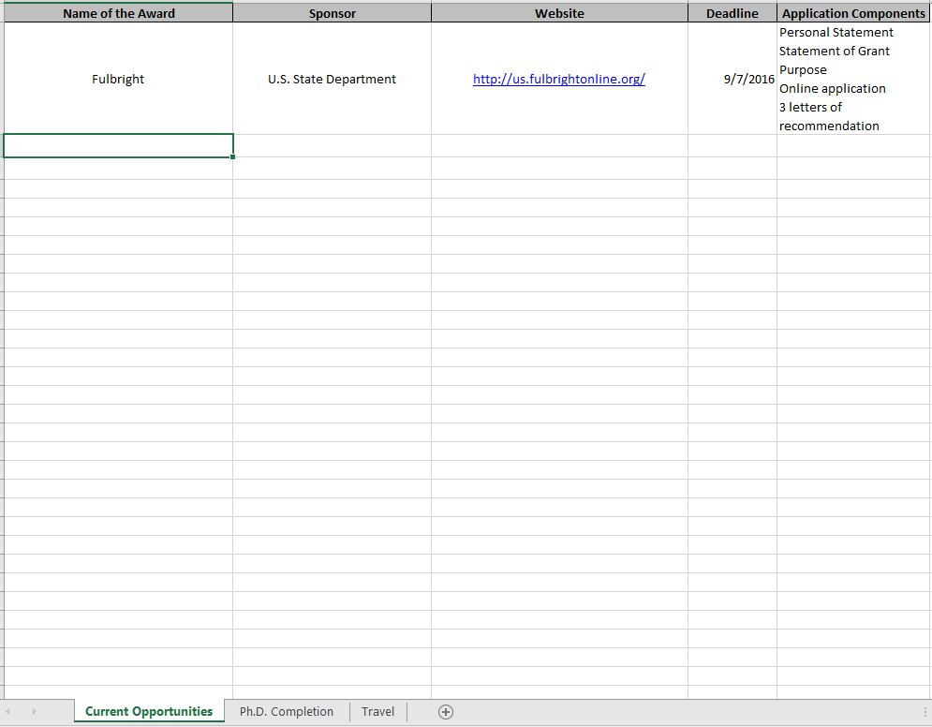
Organizing Your Funding Search
THE FLORIDA STATE UNIVERSITY | THE GRADUATE SCHOOL
Notes:
Grant writing skills
Professional development
Personal growth
Feedback regarding your research from multiple sources
Generate a list of funding opportunities
Reasonable & manageable
“Fit”
Deadlines
Moving Parts

Slide 10
Upcoming Workshops
The Basics of Proposal Writing
September 19 | 2pm | HSF Great Hall
Florida Gubernatorial Fellowship Program Campus Visit
September 28 | 2pm | HSF 3009
November 7 | 2pm | HSF 3009
Crafting a Competitive Personal Statement
September 22 | 12pm | HSF 3009
Writing the CV/Resume
September 20 | 2pm | HSF Great Hall
Workshop your CV Labs
October 5 | 2:3opm | HSF 3009
October 6 | 3:30pm | HSF 3009
Letters of Recommendation and Cover Letters
October 3 | 2pm | HSF 3009
THE FLORIDA STATE UNIVERSITY | THE GRADUATE SCHOOL
Notes:
Why use a funding database?

Slide 11
Contact Information
The Office of Graduate Fellowships and Awards
Honors, Scholars, Fellows House
127 Honors Way
ogfa-info@fsu.edu
ogfa.fsu.edu
850-645-0850
@ogfafsu
/ogfafsu
THE FLORIDA STATE UNIVERSITY | THE GRADUATE SCHOOL

